Slide 1
Big Data Analysis
Spark part 3

Slide 2
Spark 03 - Text Analysis Basics

Slide 3
Last time…

Slide 4
Word Count
Word Count is the first step
Now let’s move further

Slide 5
Lecture Objective
Elaborate basic text analysis
Preprocessing to form the term vocabulary
  Documents
  Tokenization
  What terms do we put in the index?
Postings
  Faster merges: skip lists
  Positional postings and phrase queries

Slide 6





Text analysis pipeline
Documents to
be indexed.
Friends, Romans, countrymen.
Tokenizer
Token stream.
Friends
Romans
Countrymen
Linguistic modules
Modified tokens.
friend
roman
countryman
Indexer
friend
2
4
roman
1
2
Inverted index.
countryman
13
16

Slide 7
Text Analysis
Digital documents that are the input to an indexing process are typically bytes in a file or on a web server.
The best format is RAW text (e.g. txt).
The first step of processing is to convert this byte sequence into a linear sequence of characters.

Slide 8
Parsing a document
What format is it in?
  pdf/word/excel/html?
What language is it in?
What character set is in use?
Each of these is a classification problem, which we will study later in the course.
But these tasks are often done heuristically …

Slide 9
Complications: Format/language
Documents being indexed can include docs from many different languages
  A single index may have to contain terms of several languages.
Sometimes a document or its components can contain multiple languages/formats
  French email with a German pdf attachment.

Slide 10
Tokens and Terms

Slide 11
Tokenization
Input: “Friends, Romans and Countrymen”
Output: Tokens
  Friends,
  Romans
  and
  Countrymen
Each such token is now a candidate for an index entry, after further processing
  Described below
But what are valid tokens to emit?

Slide 12
Tokenization
Issues in tokenization:
  Finland’s capital →
  Finland? Finlands? Finland’s?
  Hewlett-Packard → Hewlett and Packard as two tokens?
    state-of-the-art: break up hyphenated sequence.
    co-education
    lowercase, lower-case, lower case ?
    It’s effective to get the user to put in possible hyphens
  San Francisco: one token or two? How do you decide it is one token?

Slide 13
Numbers
3/12/91 Mar. 12, 1991
55 B.C.
B-52
My PGP key is 324a3df234cb23e
(800) 234-2333
  Often have embedded spaces
  Often, don’t index as text
    But often very useful: think about things like looking up error codes/stack traces on the web
  Will often index “meta-data” separately
    Creation date, format, etc.

Slide 14
LabS03_1 - Tokenization
Refer to the code details:
  LabS03_1_Tokenization

Slide 15
Stop words
With a stop list, you exclude from dictionary entirely the commonest words. Intuition:
  They have little semantic content: the, a, and, to, be
  There are a lot of them: ~30% of postings for top 30 words

Slide 16
LabS03_2 – Stop words
Refer to the code details:
  LabS03_2_Stopwords

Slide 17
Stop words
But the trend is away from doing this:
  Good compression techniques means the space for including stopwords in a system is very small
  Good query optimization techniques mean you pay little at query time for including stop words.
  You need them for:
    Phrase queries: “King of Denmark”
    Various song titles, etc.: “Let it be”, “To be or not to be”
    “Relational” queries: “flights to London”

Slide 18
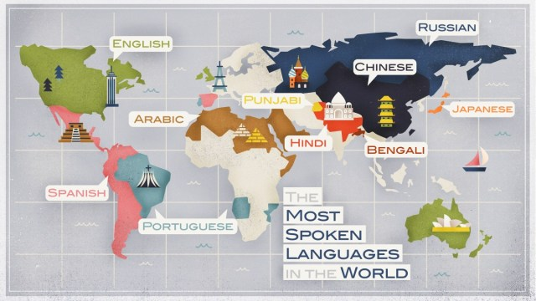
English is not the only language…

Slide 19
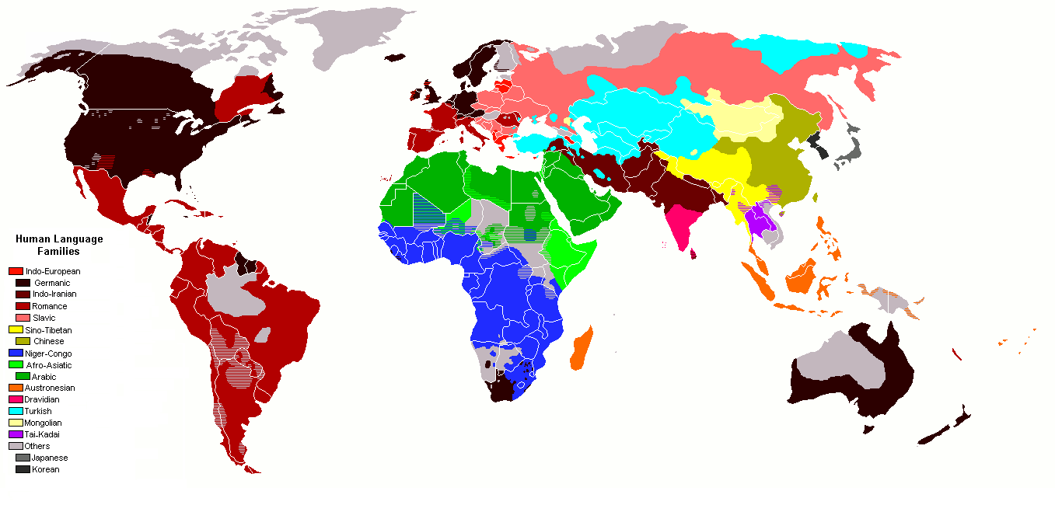
English is not the only language…

Slide 20
Language issues
French
  L'ensemble → one token or two?
    L ? L’ ? Le ?
    Want l’ensemble to match with un ensemble
German noun compounds are not segmented
  Lebensversicherungsgesellschaftsangestellter
  ‘life insurance company employee’
  German retrieval systems benefit greatly from a compound splitter module

Slide 21
Language issues
Chinese and Japanese have no spaces between words:
  莎拉波娃现在居住在美国东南部的佛罗里达。
  Not always guaranteed a unique tokenization
Further complicated in Japanese, with multiple alphabets intermingled
  Dates/amounts in multiple formats
  フォーチュン500社は情報不足のため時間あた$500K(約6,000万円)

Slide 22
Language issues
Arabic (or Hebrew) is basically written right to left, but with certain items like numbers written left to right
Words are separated, but letter forms within a word form complex ligatures
← → ← → ← start
‘Algeria achieved its independence in 1962 after 132 years of French occupation.’
With Unicode, the surface presentation is complex, but the stored form is straightforward

Slide 23
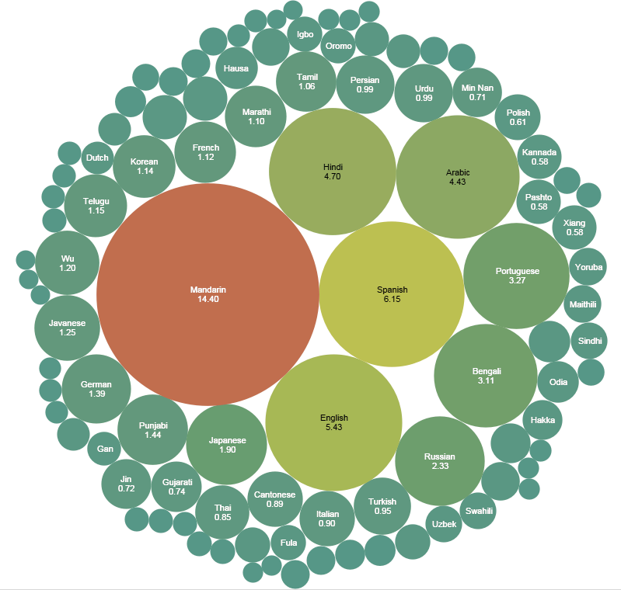
English is not the only language…

Slide 24
Chinese is so different
南京市长江大桥
  南京市/长江/大桥
  南京/市长/江大桥
我们中出了一个叛徒
  我们中/出了/一个/叛徒

Slide 25
Chinese is so different
这几天天天天气不好。
我有一个小本本本来很干净。
用毒毒毒蛇毒蛇会不会被毒毒死？
你去班上数数数数数不好的有多少。
多亏跑了两步，差点没上上上上海的车。
明明明明明白白白喜欢他，可她就是不说
今天下雨，我骑车差点摔倒，好在我一把把把把住了

Slide 26
Chinese is so different
货拉拉拉不拉拉布拉多，取决于货拉拉拉拉布拉多时拉布拉多拉不拉粑粑。
校长说：校服上除了校徽别别别的，让你们别别别的别别别的你非别别的！
来到杨过曾经生活的地方，小龙女动情地说：“我也想过过过儿过过的生活”
人要是行，干一行行一行，一行行行行行，行行行干哪行都行。要是不行，干一行不行一行，一行不行行行不行，行行不行干哪行都不行。

Slide 27
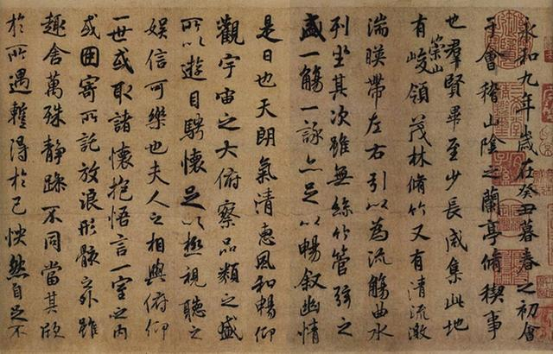
Chinese is so different

Slide 28
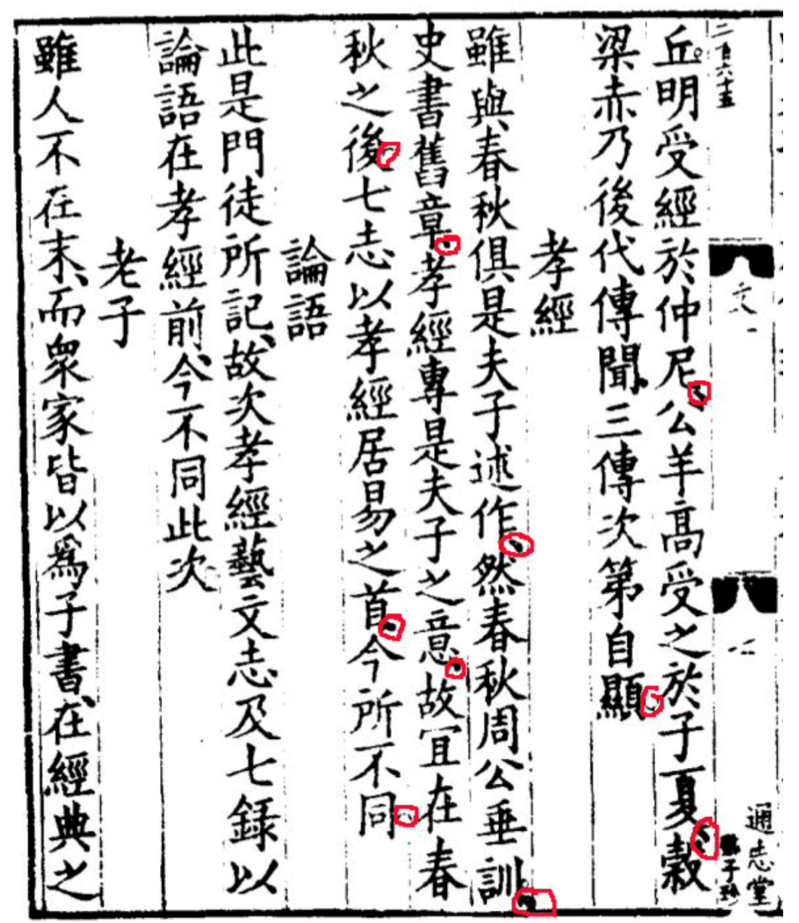
Chinese is so different

Slide 29
LabS03_3 – Chinese text processing
Install Jieba (Chinese tokenization):
  pip install jieba -i https://pypi.tuna.tsinghua.edu.cn/simple
Refer to the code details:
  LabS03_3_Chinese

Slide 30
N-gram
An n-gram is a contiguous sequence of n items from a given sample of text or speech.
The items can be letters, words or base pairs according to the application.
The n-grams typically are collected from a text or speech corpus.
When the items are words, n-grams may also be called shingles.

Slide 31
N-gram
1-gram word
  I, you, he, be, not…
2-gram word
  I love, love you, you and, be or, or not
3-gram word
  I love you, you and me, be or not, not to be
4-gram word
  To be or not, he is a man

Slide 32
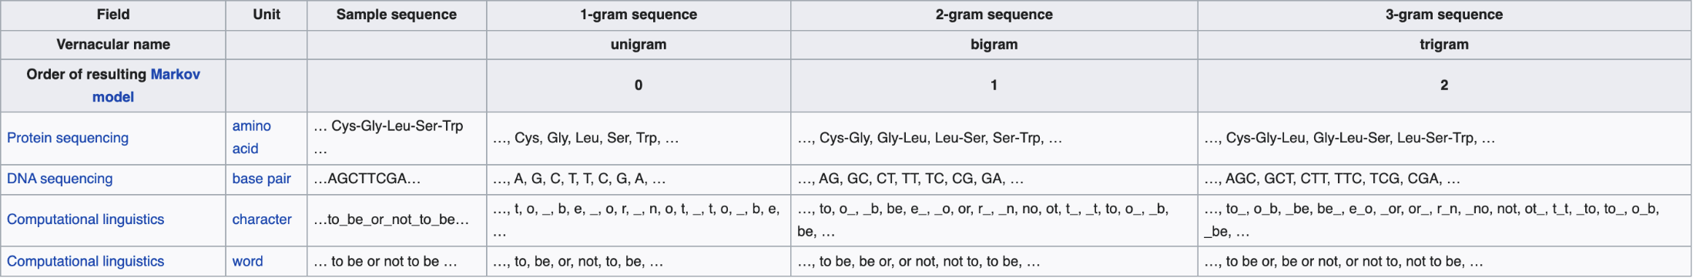
N-gram

Slide 33
LabS03_4 - N-gram
Refer to the lab code:
  LabS03_4_Ngram

Slide 34
Other technique
Lemmatization implies doing “proper” reduction to dictionary headword form
  car, cars, car's, cars' → car
Stemming reduces terms to their “roots” before indexing
  automate(s), automatic, automation → automat
  Spark NLP: State-of-the-Art Natural Language Processing Package
spark-nlp · PyPI

Slide 35
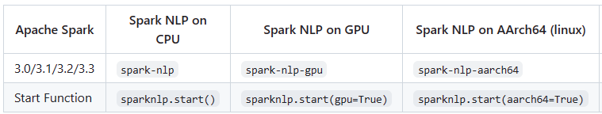
Other technique
  Refer to the lab code
  -LabS03_5_NLP
  -LabS06_Lemmatizer
pip install spark-nlp==3.3.2 -i https://pypi.tuna.tsinghua.edu.cn/simple
https://github.com/JohnSnowLabs/spark-nlp#packages-cheatsheet

Slide 36
Language-specificity
Many of the above features embody transformations that are
  Language-specific and
  Often, application-specific
CJK (Chinese-Japanese-Korean) language family is very different due in language/text processing

Slide 37
Conclusion
This is a basic example of text analysis and processing in English and Chinese languages, as you know languages are so different
Tokenization, Stopwords, N-gram, Lemmatization, and stemming, etc.
You can also try other languages Japanese/Korean/French/German…

Slide 38
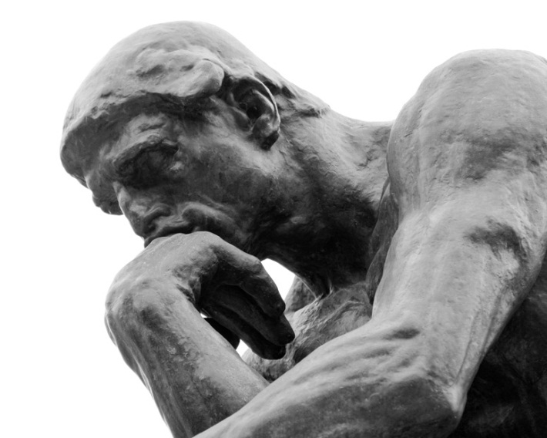
Questions?

